Slide 1
eVtol simulation Unit Test Plan
Jim Wang
12/11/2023

Slide 2
Evtol simulation unit test plan
Introduction
Test cases – Charger Class
Test cases – EvtolVehicle Class
Test cases – SimulateManager Class
Google Test report
Code Coverage report
Conclusion

Slide 3
Introduction
This document provides unit tests for the C++ code implementing a simulation of EVTOL (Electric Vertical Take-Off and Landing) vehicles and chargers. The code includes classes for Charger, EvtolVehicle, and SimulateManager.
All test cases are associating the Google Test project in Github repository under tests folder, test comments are assigned to each GTest test suite, and test fixture.
Testing Environment:
Testing Framework: Google Test (GTest)
Compiler: C++ compiler supporting C++11
eVTOL SW Version: v01-00-03

Slide 4
Test Plan & test cases – Charger class
Test Cases
1. Charger Availability
Description: Check if the isAvailable method returns the correct availability status
Test Steps:
Create a Charger object
Check the initial availability status using the isAvailable method
Expected Result: The method should return true initially
2. Charger Occupation and Release
Description: Check if the occupy and release methods update the availability status correctly
Test Steps:
Create a Charger object
Call the occupy method and check the availability status
Call the release method and check the availability status
Expected Result: The availability status should be false after occupy and true after release

Slide 5
Test Plan & test cases – Charger class
Test Cases
3. Charger ID Assignment
Description: Check if the setId method assigns the charger ID correctly.
Test Steps:
Create a Charger object.
Call the setId method with a valid ID.
Check the assigned ID using the getChargerId method.
Expected Result: The charger should have the assigned ID.
Invalid Charger ID Handling
Description: Check if the setId method handles invalid IDs properly.
Test Steps:
Create a Charger object.
Call the setId method with both valid/invalid ID.
For calling the setId with invalid ID, a warning message will present with ID reported
Expected Result: The charger should handle an invalid ID without assigning it.

Slide 6
Test Plan & test cases – EvtolVehicle Class
Test Cases
1. Flight Simulation
Description: Check if the simulateFlight method updates flight-related parameters correctly.
Test Steps:
Create an EvtolVehicle object.
Simulate flight for a specific duration.
Check the updated flight time, distance traveled, and passenger miles.
Expected Result: Flight time, distance traveled, and passenger miles should be updated correctly.
2. Charging Simulation
Description: Check if the simulateFlight method updates charging-related parameters correctly.
Test Steps:
Create an EvtolVehicle object.
Simulate charging for a specific duration.
Check the updated charging time and charger ID.
Expected Result: Charging time and charger ID should be updated correctly.

Slide 7
Test Plan & test cases – EvtolVehicle Class
Test Cases
3. Set Minutes Left
Description: Check if the set_int_Minutes method sets the minutes left correctly.
Test Steps:
Create an EvtolVehicle object.
Call the set_int_Minutes method with a specific number of minutes.
Check the minutes left using the get_int_Minutes method.
Expected Result: The minutes left should be set correctly.

Slide 8
Test Plan & test cases – simulatemanager Class
Test Cases
Charger Available Check
Description: Check if the getAvailableCharger method returns the correct charger based on vehicle
charger ID.
Test Steps:
Create a SimulateManager object.
Create Charger objects and set their availability status.
Call the getAvailableCharger method with different vehicle charger IDs.
Expected Result: The method should return the correct charger based on the availability status and
vehicle charger ID.
Additional Scenario: Ensure the method returns the last charger object for an invalid vehicle charger ID.
Run Simulation
Description: Check if the runSimulation method calculates and prints the correct final output statistics.
Test Steps:
Create a SimulateManager object.
Run the simulation.
Check if the calculated average flight time, distance traveled, time charging, faults, and passenger miles match the expected results.
Expected Result: The average statistics should be calculated correctly and printed.

Slide 9
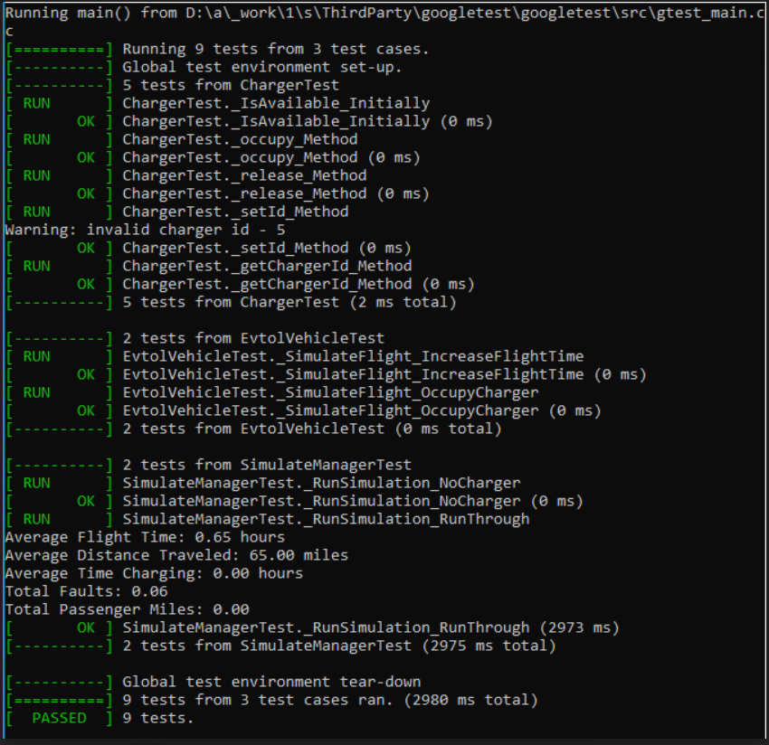
Google test result
There are 9 test results from 3 Class Google Test cases
Google Test project is uploaded to Github repository under tests folder

Slide 10
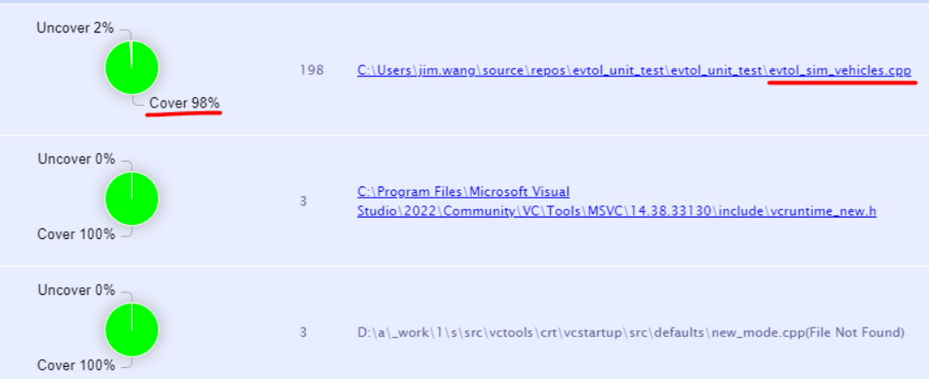
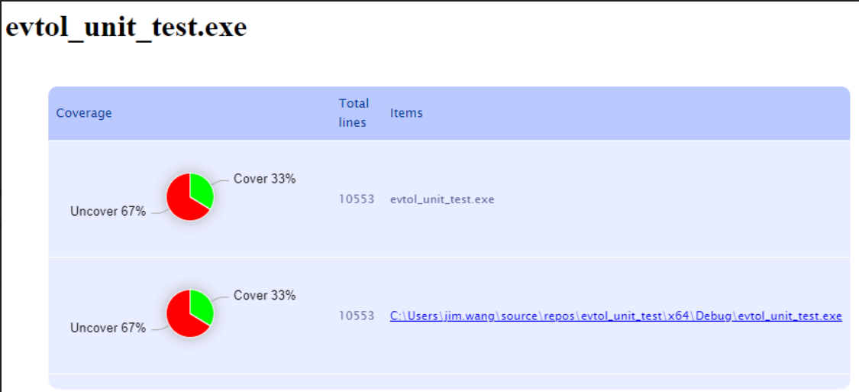
Code coverage report
Code coverage report – 98%
Built application coverage report – 33%

Slide 11
Conclusion
These detailed functional unit tests cover various scenarios for the Charger, EvtolVehicle, and SimulateManager classes, ensuring that each class behaves as expected under different conditions.
All detailed test actions are included in Google Test project on eVTOL Github repository under tests folder.

